Slide 1

Project Updates-1
Cybersecurity Assessment Report Automation Tool
Assigned by- Gopal Mishra

Slide 2
A Behavior-Based Approach for Malware Detection
Malware is a fast-growing threat to information technology systems. Traditional signature-based detection methods are not enough to combat this threat. A behavior-based approach focuses on the activities of malware during infection.

Slide 3
The Use of Handles in Malware Detection
Handles are abstraction pointers used to identify and access system objects without knowing their exact locations in memory.
By analyzing the characteristics of handle usage by benign and malicious software, we can distinguish between the two classes.
The number of handles opened by a process can indicate potential malicious activity.

Slide 4
The Automated Malware Detection Mechanism
2
3
1
The approach utilizes memory forensics, information retrieval, and machine learning techniques.
Memory forensics involves analyzing a memory dump to extract evidence of malicious activity.
Information retrieval and machine learning are used to train the classifier to distinguish between benign and malicious handles.

Slide 5
Experimental Results
The dataset consisted of 3,130 malware samples and 1,157 benign software samples.
The experiments achieved a malware detection rate of 91.4% with precision and recall of 89.8% and 91.1%, respectively.
The random forest model outperformed the k-nearest neighbor and support vector machine models.
Restricted | © Siemens 2023 | Aniket | Cyber Security | 2023-06-07

Slide 6
Differences between Benignware and Malware in Handle Usage
Object Type | Average for Benignware | Average for Malware
Desktop | 1.92 | 1.85
Device | 22.8 | 25.34
Directory | 2.21 | 2.35
Event | 70.58 | 94.92
File | 22.80 | 25.34
IOCompletion | 1.06 | 2.31
Job | 0.01 | 0.38
Key | 32.79 | 49.66
KeyedEvent | 0.56 | 0.93
Mutant | 11.35 | 21.84
Port | 7.51 | 12.76
Process | 0.81 | 2.43
Section | 8.48 | 27.12
Semaphore | 10.91 | 12.59
Thread | 14.38 | 20.61
Timer | 2.01 | 2.85
Token | 0.45 | 0.09
WindowStation | 2.01 | 2.01
WmiGuid | 0.18 | 0.02
A Behavior-Based Approach for Malware Detection | SpringerLink

Slide 8
Conclusion
Cybersecurity Assessment Report Automation Tool can provide a comprehensive and efficient way to identify and prioritize vulnerabilities in a system
it can save time and resources while providing a more accurate and up-to-date assessment of the system’s security.
tools should be used in conjunction with other security measures and multiple user used it at a time
1
2
3

Slide 9
Krieger Project
Project Updates-2
Assigned by- Anjana Prabhakar

Slide 10
Signature Based Detection:
A widely applied method for identifying the malware is Signature Based Detection.
This approach is to compare the code of program with a list of known malware signatures.
The program will be flagged as potentially malicious if a match is detected.
While signature based detection can be an efficient way to detect existing malware, its ability to identify new and unknown threats could also be limited.

Slide 11
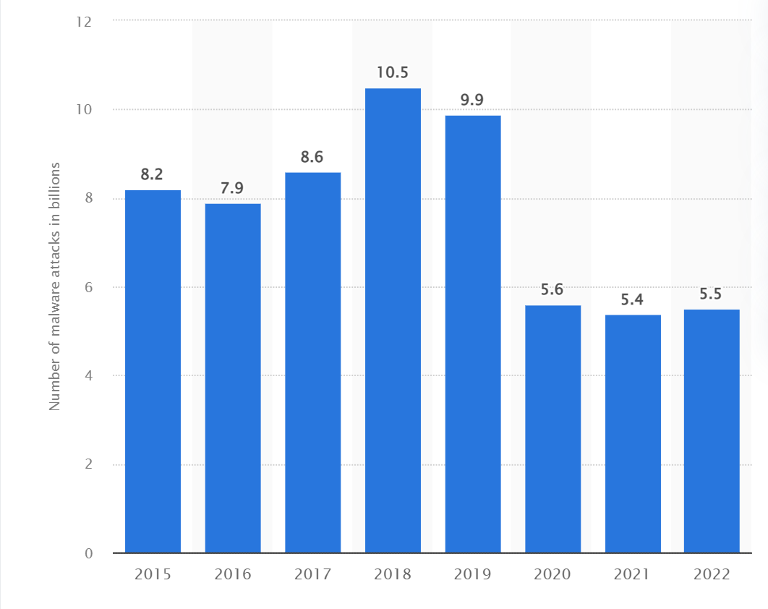
Sourced by SonicWall Capture Labs
A report is publish by Ani Petrosyan In 2022, 5.5 billion malware attacks were detected around the world with the majority of these attacks occurring in the Asia-Pacific region
2023 SonicWall Cyber Threat Report | SonicWall

Slide 12
How it Works:
An antivirus that has a set of predefined static signatures(fingerprints) representing known network threats, is part of this type of detection.
When an antivirus scanner launches, it begins to generate the correct signatures for each file as well as compare them with those in its database.
For signature matches, it is keeping a check on network traffic.

Slide 13
Conclusion:
As malware became more sophisticated, malware authors began using new techniques, like polymorphism, to change their pattern each time their creation spread from one system to the next. As such, this minimized the effectiveness of a simple signature detection.
So, with a new method of detection using an algorithm based to find the source code that is indicate the threat heuristic detection that judges the code based on its behavior.
There is a need for a more layered security approach, where signature-based IDS is used in conjunction with other security methods. These include AI threat detection, advanced malware scanning, and remote security management.

